Slide 1
Memory Forensics
The Theory

Slide 2
Forensics
Forensic science is the scientific method of gathering and examining information about the past.

Slide 3
Computer Forensics
Is to examine digital media in a forensically sound manner with the aim of
Identifying
Preserving
Recovering
Analyzing
And presenting
Facts
and Opinions
about the digital information

Slide 4
Analysis Process
Preparation
Acquisition
Identification
Extraction
Analysis
Reporting

Slide 5
Analysis Types
Storage Analysis
Volume Analysis
File system Analysis
Database Analysis
Memory Analysis
Network Analysis
Application Analysis
Swap Analysis

Slide 6
Analysis Types
Storage Analysis
Volume Analysis
File system Analysis
Database Analysis
Memory Analysis
Network Analysis
Application Analysis
Swap Analysis
Notes:
Relevent

Slide 7
Forensic Techniques
Cross-drive Analysis
Live Analysis
File Recovery
Stochastic Analysis
Stegnograpy

Slide 8
Sources
Physical Disks
Packet Capture
Swap/Pagefile
Hibernation File
Firmware
Volatile Memory

Slide 9
Sources
Physical Disks
Packet Capture
Swap/Pagefile
Hibernation File
Firmware
Volatile Memory
Notes:
Interested in

Slide 10
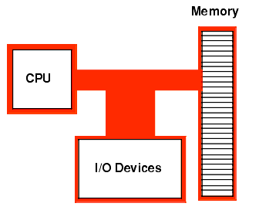
Memory
Storage
Volatile
Temporary Data
Fast Access
RAM
Swap/Pagefile

Slide 11
Memory Acquisition
Acquisition of Volatile Memory Contents (RAM) bit-by-bit to a Non-Volatile Storage (Image File).
Hardware Based Tools
WindowsSCOPE CaptureGUARD PCIe
Goldfish (Firewire/ Mac)
Software Based Tools
Memoryze
KntDD
FTKImager
LiME
OSXPMem
…
Requires Kernel Mode/Physical Access

Slide 12
Real(Physical) Memory
Actual RAM Hardware
Shared
Devices
Kernel
Drivers
Processes
System wide address space
Defined by H/W capability
Managed by OS Memory Manager

Slide 13
Virtual Memory
An abstraction of Real Memory
Per-process Isolation
Shared if required
Shared by process
Code
Data
Per-process address space
User Mode
Kernel Mode
Managed by Process

Slide 14
Virtual → Real Mapping
Conversion of Virtual Address to Read Address
RAM
Swap/Pagefile
Page : Fixed size allocation unit
Virtual Memory
Real Memory
Page Table
A table to convert virtual page to real page
Page Directory
A list of page tables
Level2 Pages

Slide 15
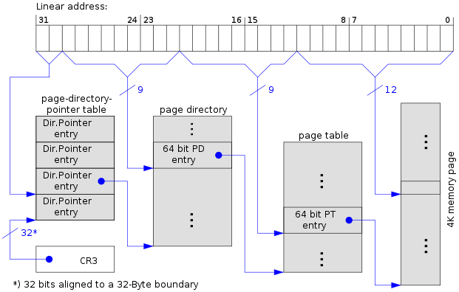
32bit Address Space

Slide 16
Forensic Tools
0th Generation
Before 2004
‘strings’
‘grep’
1st Generation
2004-2005
Tools for structured analysis
Parsing OS structures
Crash dump analysis

Slide 17
Forensic Tools
2nd Generation
2005-2010
Generic, automated tools
Multiple OS support
Volatality
Rekall
3rd Generation
2010 & Later
Emphasis on Visualization
Cloud/VM based
MoonSols LiveCloudKd
Microsoft LiveKd

Slide 18
Volatility
A advanced memory forensics framework.
Written in python.
Follows modular plug-in architecture.
Supports many systems and architectures.
Open source.
Current release 2.4.1
Community plugins to automate volatility.

Slide 19
Dump formats
Also known as AddressSpaces in volatility
Define organization of memory content from H/W perspective
Virtual → Real Mapping
Location of PDE
Supported
intel (x86)
amd64(x64)
Crashbmp (Window Kernel Crash Dump)
elfcoredump(Linux Core Dump)
MachO (Mac OSX)
vmem (VMWare/Vbox)

Slide 20
Profiles
Organization/Location of memory content from Operating System perspective.
Locations of important Objects
KDBG
_KPROCESS
_EPROCESS
PTE
SSDT
IDT

Slide 21
KDBG
Kernel Debugger Block (Windows)
Setup at system startup to support kernel level debugging.
Contains pointers to
PsActiveProcessHead → All Processes
PsLoadedModuleList → All Drivers
Helps in identifying physical address of “ntoskrnl.exe”
DEMO : pslist, modules, kdbgscan

Slide 22
_EPROCESS
Executive Process Structure
Links to
PEB (User Mode Structure)
_KPROCESS (Kernel Mode Structure)
KDBG->PsActiveProcessHead points to a list (LIST_ENTRY) of _EPROCESS structures
pslist traversed this list to discover all processes.
Notes:
DEMO: pslist

Slide 23
PEB
Process Environment Block
User mode part of _EPROCESS
Exclusive process access.
Pointers for
Ldr
InInitializationOrderModuleList
InLoadOrderModuleList
InMemoryOrderModuleList
DEMO: “dlllist –p” traversed these lists to discover loaded modules.

Slide 24
Hooking
User Mode
IAT
Inline
Event
Virtual Method
Kernel Mode
IAT
SSDT
IRP

Slide 25
SSDT
System Service Dispatcher Table
Handling System Calls
SysemCall
A request to kernel for executing privileged code.
EAX ← System Call Number
SSDT
Pointers to System Call handler routines
SystemCall → Index in the table
Malware hooks(Overwrites) handler to hide itself.
Files
Registry Keys
_KTHREAD/_ETHREAD points to SST
DEMO: ssdt, theads
Notes:
KeServiceDescriptorTable
KeServiceDescriptorTableShadow

Slide 26
IDT
Interrupt Descriptor Table
List of interrupt handlers
Interrupt number → index
User Callable interrupts
Int3
Int4
…
Malwares hook(overwrite) to handle interrupts themselves
Intercept debugger breakpoints
DEMO: idt

Slide 27
Anti Forensics
Unlinking PEB->Ldr.* lists
Hide selected DLL from Loaded Modules List.
ldrmodules indicates dlls missing from lists
Unlinking _EPROCESS list
Unlink _EPROCESS to hide selected process from taskmanager.
Defeated by correlating from Active Threads list.
Unlinking PsLoadedModuleList
Can hide Drivers from showing up in list
Notes:
DEMO: ldrmodules, psxview

Slide 28
Challenges
Malwares running is kernel mode can interfere with dumping process
Omit selected pages
Omit selected structures
Corrupt output
Footprints of dumping process.
Unavailability of Swap/Pagefile.

Slide 29

THATSITFORNOW

